Slide 1
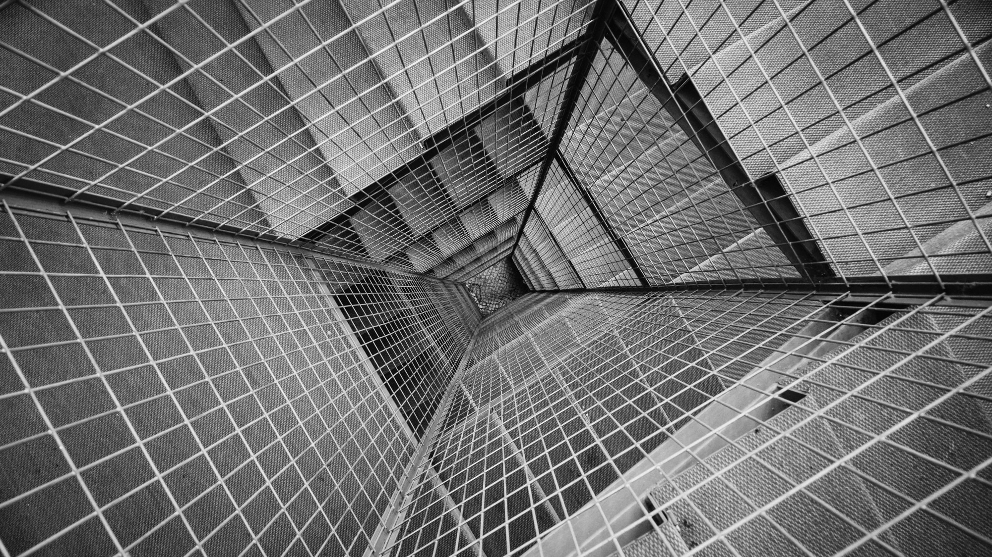
TCP/IP and osi model
Matthew R. Kisow, D.Sc.

Slide 2

TCP/IP and osi
Network Communication Model

Slide 3
TCP/IP Model
Network Communication Model
The TCP/IP ^{[1, 3]} model was designed and developed by the Department of Defense (DoD) during the 1960’s and is based on a standard suite of protocols ^{[2]}.
A protocol is a set of rules that describe how data is sent over the Internet or other network ^{[2]}.
This suite of protocols are the Transmission Control Protocol (TCP) and the Internet Protocol (IP) ^{[1]} .

Slide 4
OSI Model
Network Communication Model
The Open System Interconnect (OSI) ^{[1, 3]} model is a conceptual framework ^{[3, 4]} designed by the International Standards Organization. This theoretical model was conceived in the 1970’s and published in 1984 ^{[4]} .
This model expands on the TCP/IP model to simplify how network communication is distributed between the layers ^{[1, 3, 4]}.

Slide 5
Network Models
Network Communication Models
The TCP/IP model ^{[1]} and the OSI model ^{[3]} are the most widely used network communication models.
The TCP/IP model is used in practice; while the OSI model is used to simplify the TCP/IP model ^{[1, 3]} .
The OSI Model separates out the TCP/IP Model’s Application layer into three distinct layers: Application, Presentation and Session.
The OSI Model also separates out the TCP/IP Model’s Network Access layer into two distinct layers: Data Link and Physical.

Slide 6
TCP/IP Model
Network Communication Layers
The TCP/IP model consists of four layers:
Application
Transport
Network
Network Access

Slide 7
OSI Model
Network Communication Layers
The OSI model consists of seven (7) layers and is the model that guides developers and vendors in the creation and operation of digital communication products ^{[4]}.
Application
Presentation
Session
Transport
Network
Datalink
Physical

Slide 8
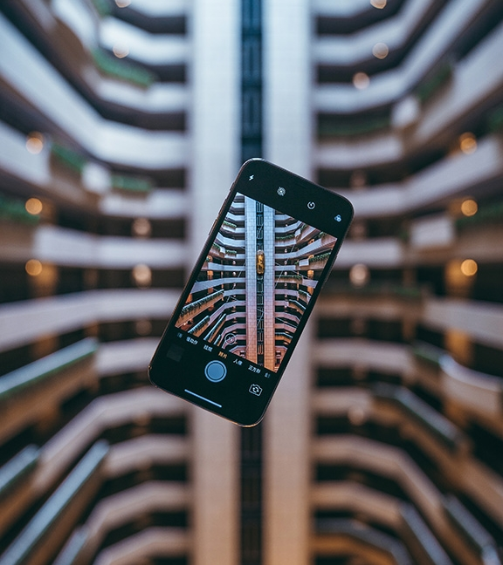
REMEMBERING

Slide 9
HOW TO REMEMBER THE MODELS
Remembering the Network Communication Layers
A memory mnemonics’ aids in information retention and retrieval. The following are mnemonics' for remembering these two models:
OSI Model
All People Seem To Need Data Processing
Please Do Not Throw Sausage Pizza Away
TCP/IP Model
Armadillos Take In New Ants

Slide 10
Network Layers

Slide 11
Application Layer
OSI Model Network Layers
Provides network services to the end users:
Used for applications specifically written to run over the network.
Allows access to network services that support applications.
Directly represents the services that directly support user applications.
Handles network access, flow control and error recovery.
EXAMPLES OF PROTOCOLS:
(File Transfer Protocol) FTP
(Simple Mail Transfer Protocol) SMTP
(Domain Name Service) DNS
MANY OTHERS

Slide 12
Presentation Layer
OSI Model Network Layers
External Data Representation (XDR) sits at the presentation level. It converts local representation of data to its canonical form and vice versa. The canonical uses a standard byte ordering and structure packing convention, independent of the host:
Translates from application to network format and vice-versa.
All different formats from all sources are made into a common uniform format that the rest of the OSI model can understand.
Responsible for protocol conversion, character conversion, data encryption / decryption, expanding graphics commands, data compression.
Sets standards for different systems to provide seamless communication from multiple protocol stacks.
Not always implemented in a network protocol.
EXAMPLES OF PROTOCOLS:
THERE ARE NO PROTOCOLS AT THIS LAYER

Slide 13
SESSION Layer
OSI Model Network Layers
The session protocol defines the format of the data sent over the connections. For example, the Network File System (NFS) uses the Remote Procedure Call (RPC) for its session protocol. RPC may be built on either the Transmission Control Protocol (TCP) or User Datagram Protocol (UDP). Login sessions uses TCP whereas NFS and broadcast use UDP:
Establishes, maintains and ends sessions across the network.
Responsible for name recognition (identification) so only the designated parties can participate in the session.
Provides synchronization services by planning check points in the data stream. For example, if the session fails, only the data after the most recent checkpoint needs to be re-transmitted.
Manages who can transmit data at a certain time and for how long.
EXAMPLES OF PROTOCOLS:
NetBIOS
Name Pipes
Mail Slots
RPC

Slide 14
TRANSPORT Layer
OSI Model Network Layers
Manages the flow control of data between parties across the network.
Divides streams of data into chunks or packets; the transport layer of the receiving computer reassembles the message from the packets.
Provides error-checking to guarantee error-free data delivery, with no losses or duplications.
Provides acknowledgment of successful transmissions; requests retransmission if some packets that don’t arrive error-free.
Provides flow control and error-handling.
EXAMPLES OF PROTOCOLS:
TCP
(Address Resolution Protocol) ARP
(Reverse Address Resolution Protocol) RARP
(NetWare Link) NWLink
NetBIOS / NetBEUI

Slide 15
NETWORK Layer
OSI Model Network Layers
Translates logical network address and names to their physical address (e.g. computername ==> MAC Address)
The Network Layer is responsible for:
addressing
determining routes for sending
managing network problems such as packet switching, data congestion and routing.
If the router can’t send data frame as large as the source computer sends, the network layer compensates by breaking the data into smaller units. At the receiving end, the network layer reassembles the data.
EXAMPLES OF PROTOCOLS:
(Internet Protocol) IP
(Address Resolution Protocol) ARP
(Reverse Address Resolution Protocol) RARP
(NetWare Link) NWLink
(Internet Control Message Protocol) ICMP
(Routing Information Protocol) RIP
(Open Shortest Path First) OSPF

Slide 16
Data link Layer
OSI Model Network Layers
The Data Link layer defines the format of data on the network. A network data frame or packet, includes the checksum, source and destination address, and data. The data link layer handles the physical and logical connections to the packet's destination, using a network interface:
Turns the packets into raw bits 100101 and at the receiving end turns bits into packets.
Handles data frames between the Network and Physical layers.
Responsible for error-free transfer of frames to other computer via the Physical Layer.
This layer defines the methods used to transmit and receive data on the network.
It consists of the wiring.
The devices used to connect the Network Interface Card (NIC) to the wiring.
The signaling involved to transmit / receive data.
The ability to detect signaling errors on the network media.
EXAMPLES OF PROTOCOLS:
(Internet Protocol) IP
(Address Resolution Protocol) ARP
(Reverse Address Resolution Protocol) RARP
(NetWare Link) NWLink
(Internet Control Message Protocol) ICMP
(Routing Information Protocol) RIP
(Open Shortest Path First) OSPF

Slide 17
Physical Layer
OSI Model Network Layers
The Data Link layer defines the format of data on the network. A network data frame or packet, includes the checksum, source and destination address, and data. The data link layer handles the physical and logical connections to the packet's destination, using a network interface.
Transmits raw bit stream over physical cable
Defines cables, cards, and physical aspects
Defines NIC attachments to hardware, how cable is attached to NIC
Defines techniques to transfer bit stream to cable
EXAMPLES OF PROTOCOLS:
IEEE 802.2 (Standard Defining Logical Link Control)
IEEE 802.11 (Wireless Standards)

Slide 18


The TCP/IP OSI Model
Network Communication Simulation
APPLICATION
APPLICATION
APPLICATION
E-Mail
E-Mail
PRESENTATION
E-Mail
E-Mail
PRESENTATION
SESSION
E-Mail
E-Mail
SESSION
TRANSPORT
TRANSPORT
TRANSPORT
E-Mail
E-Mail
NETWORK
NETWORK
NETWORK
NETWORK
NETWORK
E-Mail
E-Mail
E-Mail
DATA LINK
NETWORK
ACCESS
DATA LINK
DATA LINK
DATA LINK
E-Mail
E-Mail
E-Mail
PHYSICAL
E-Mail
PHYSICAL
E-Mail
PHYSICAL
E-Mail
PHYSICAL
Hello World
Hello World
MAC: 34:22:A8:15:F7:42
MAC: B1:2A:64:89:AF:17
ETHERNET
ETHERNET
ATM
FRAME RELAY
136.127.23.18
132.10.45.19
PORT: 16342
PORT: 25
MAC: 20:34:1F:A2:17:BF
MAC: AC:23:F1:62:45:B3

Slide 19
REFERENCES
Chauhan, A., Jain, P. (2019). Tcp/Ip Model. TCP/IP Model. Retrieved November 6, 2019, 2019, from https://www.geeksforgeeks.org/tcp-ip-model/
“Internet Protocol” (2019). Lexico Powered by Oxford. Retrieved November 6, 2019, 2019, from https://www.lexico.com/en/definition/internet_protocol
Raza, M. (2018). What Is OSI Model? 7 Layers of Osi Model Explained. Retrieved November 6, 2019, 2019, from https://www.bmc.com/blogs/osi-model-7-layers/
Shaw, K. (2018). The OSI model explained: How to understand (and remember) the 7 layer network model. Retrieved November 7, 2019, 2019, from https://www.networkworld.com/article/3239677/the-osi-model-explained-how-to-understand-and-remember-the-7-layer-network-model.html
Tanvir, K. (2001). OSI and TCP/IP Model. VIDEO SHOWING THE SIMULATION OF THE WORKING OF LAYERS OF OSI MODEL. Retrieved September 16, 2008, 2001, from https://www.sites.google.com/site/btcsit/osi-and-tcpip-model

Slide 20




QUESTIONS
Matthew R. Kisow, D.Sc.
+1 (412) 716-3814
matthew.kisow@icloud.com
https://github.com/DoctorKisow/Lecture-TCP-IP-and-OSI-Model

Slide 21

TCP/IP and OSI Model
Version: 3.0
Copyright © Matthew R. Kisow, D.Sc .2008-2021.
This presentation is available for non-commercial use, please see terms and conditions where this presentation was downloaded from.

